Slide 1




HARDWARE HACKATHON ROUND 1
-TITLE OF THE PROJECT-
TEAM ID: QXHH-19
TEAM NAME: WOX BOT
NOTE: PPT to be named as- “teamID_teamname”

Slide 2


PROBLEM UNDERSTANDING & PROPOSED IDEA
PROBLEM
In hospitals, communication delays between patient rooms and the pharmacy lead to slower response times, especially during emergencies. Manual handling of medicine requests increases workload and chances of errors. Small hospitals lack affordable automation solutions
PROPOSED SOLUTION
We propose WOX BOT, a low-cost autonomous robot that navigates hospital wards using line-following, detects medicine requests using sensors, counts them automatically, and communicates the data to the pharmacy efficiently.
Combines line following + request detection + counting system
Uses real-time wireless communication (ESP8266)
Provides low-cost automation for small hospitals
Includes visual/audio reporting (LED & buzzer)
Reduces human effort and improves response speed

Slide 3

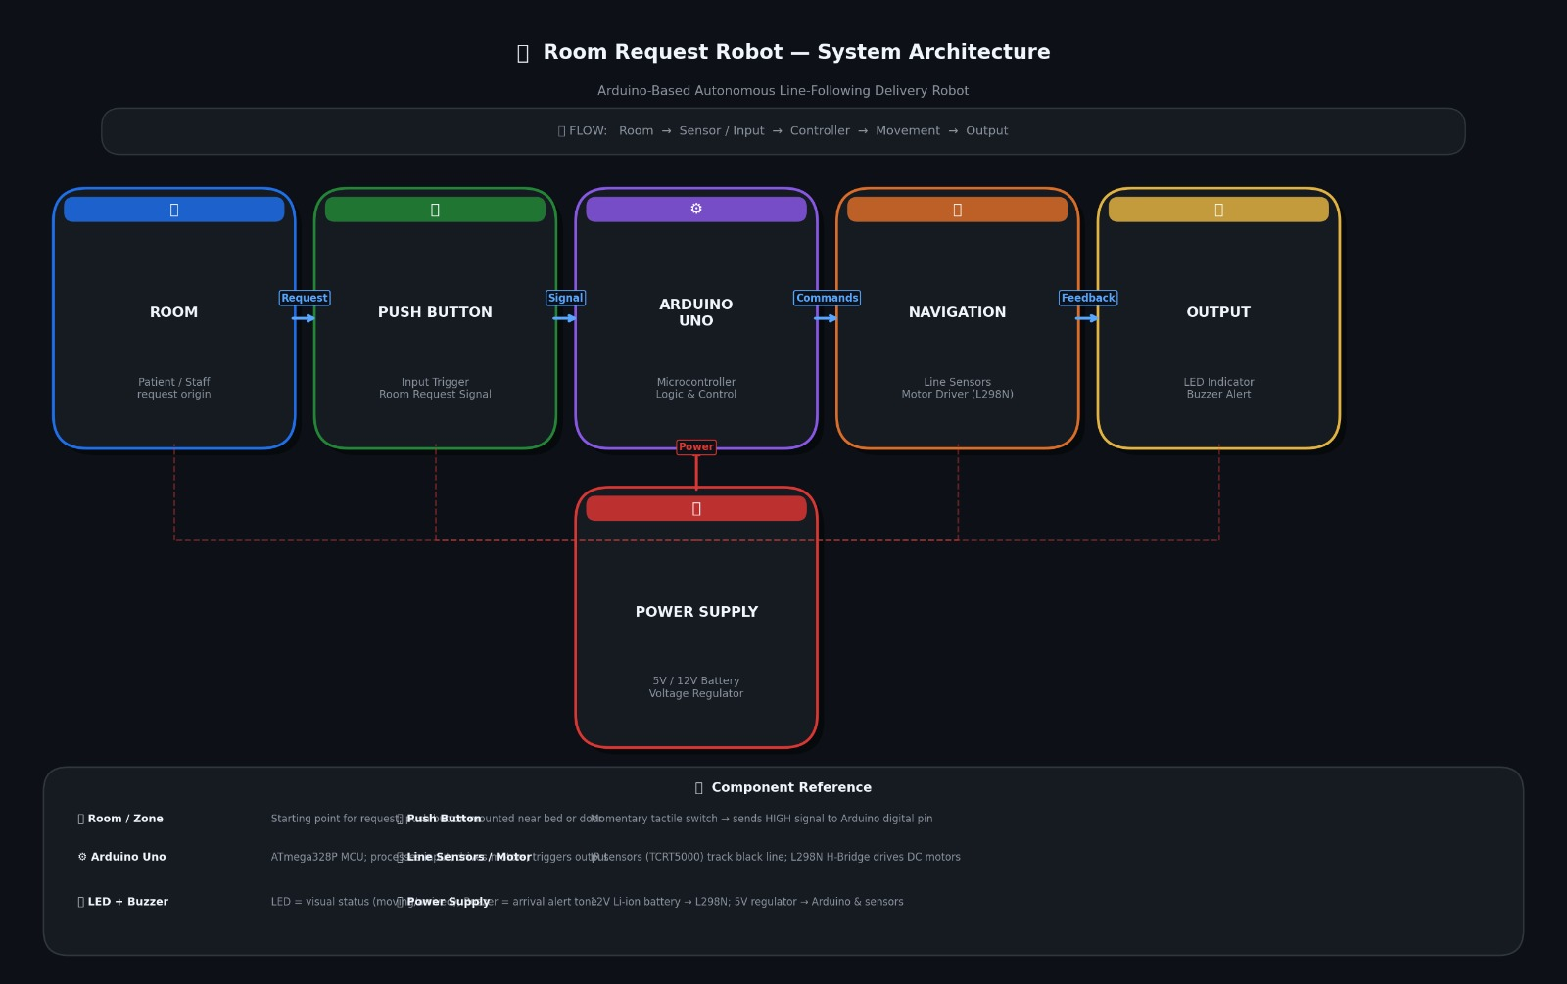
SYSTEM ARCHITECTURE/ WORKING
Step-by-step working:
1️⃣ How Request is Detected
IR sensor placed near rooms detects signal/reflection
If patient request is present → sensor outputs HIGH
Arduino identifies it as a request
2️⃣ How Robot Navigates
Robot follows predefined path using IR line-following
L298N motor driver controls wheel movement
Ultrasonic sensor detects obstacles and stops robot
3️⃣ How Data is Processed
Arduino counts number of requests detected
Stores total requests and rooms visited
ESP8266 sends data wirelessly (optional feature)
4️⃣ How Output is Given
LED blinks = number of requests
Buzzer beeps = number of rooms
Data can also be sent to mobile/dashboard

Slide 4


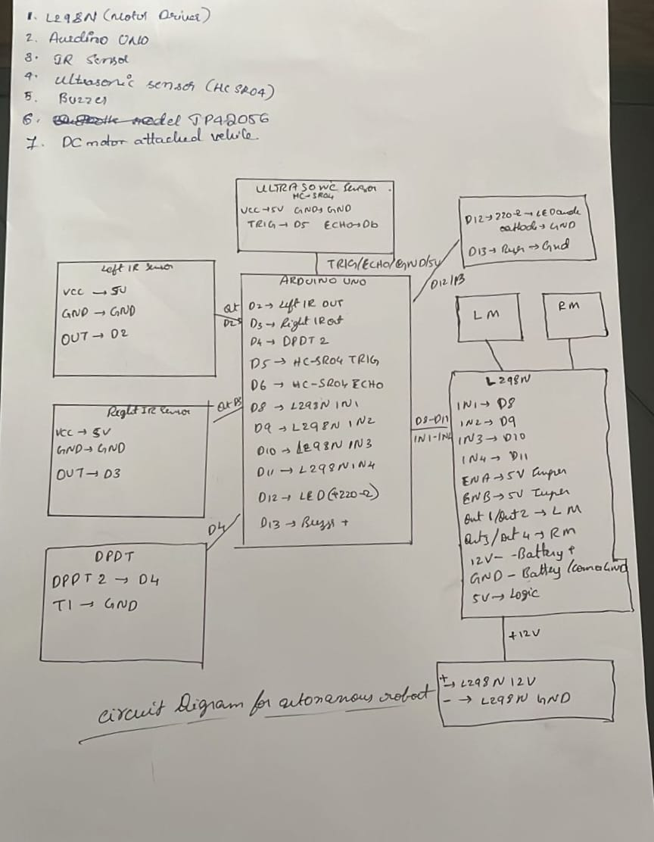
CIRCUIT DIAGRAM

Slide 5


INNOVATION, FEASIBILITY & OUTPUT
INNOVATION
Automated request handling system for hospitals
Real-time request counting and reporting
Low-cost alternative to complex hospital automation
🟦 FEASIBILITY
Built using readily available components
Cost-effective and easy to deploy
Scalable for different hospital sizes
🟦 EXPECTED OUTPUT
Reliable detection of room requests
Accurate request count
Timely communication to pharmacy
🟦 ROBOT BEHAVIOR
Follows predefined path autonomously
Stops at each room for request check
Completes operation without human intervention
🟦 REQUEST COUNT & DISPLAY
Requests counted using microcontroller logic
LED indicates total requests
Buzzer provides alert notification

